Slide 1

Apache Camel
The Integration Library
Sydney
August 2017

Slide 2

I was here on ANZAC Day 2002

Slide 3

Okay here I am

Slide 4





Claus Ibsen
@davsclaus
davsclaus
www.davsclaus.com
cibsen@redhat.com
Senior Principal Software Engineer at Red Hat
Apache Camel 8½ years working with Camel
Author of Camel in Action books

Slide 5
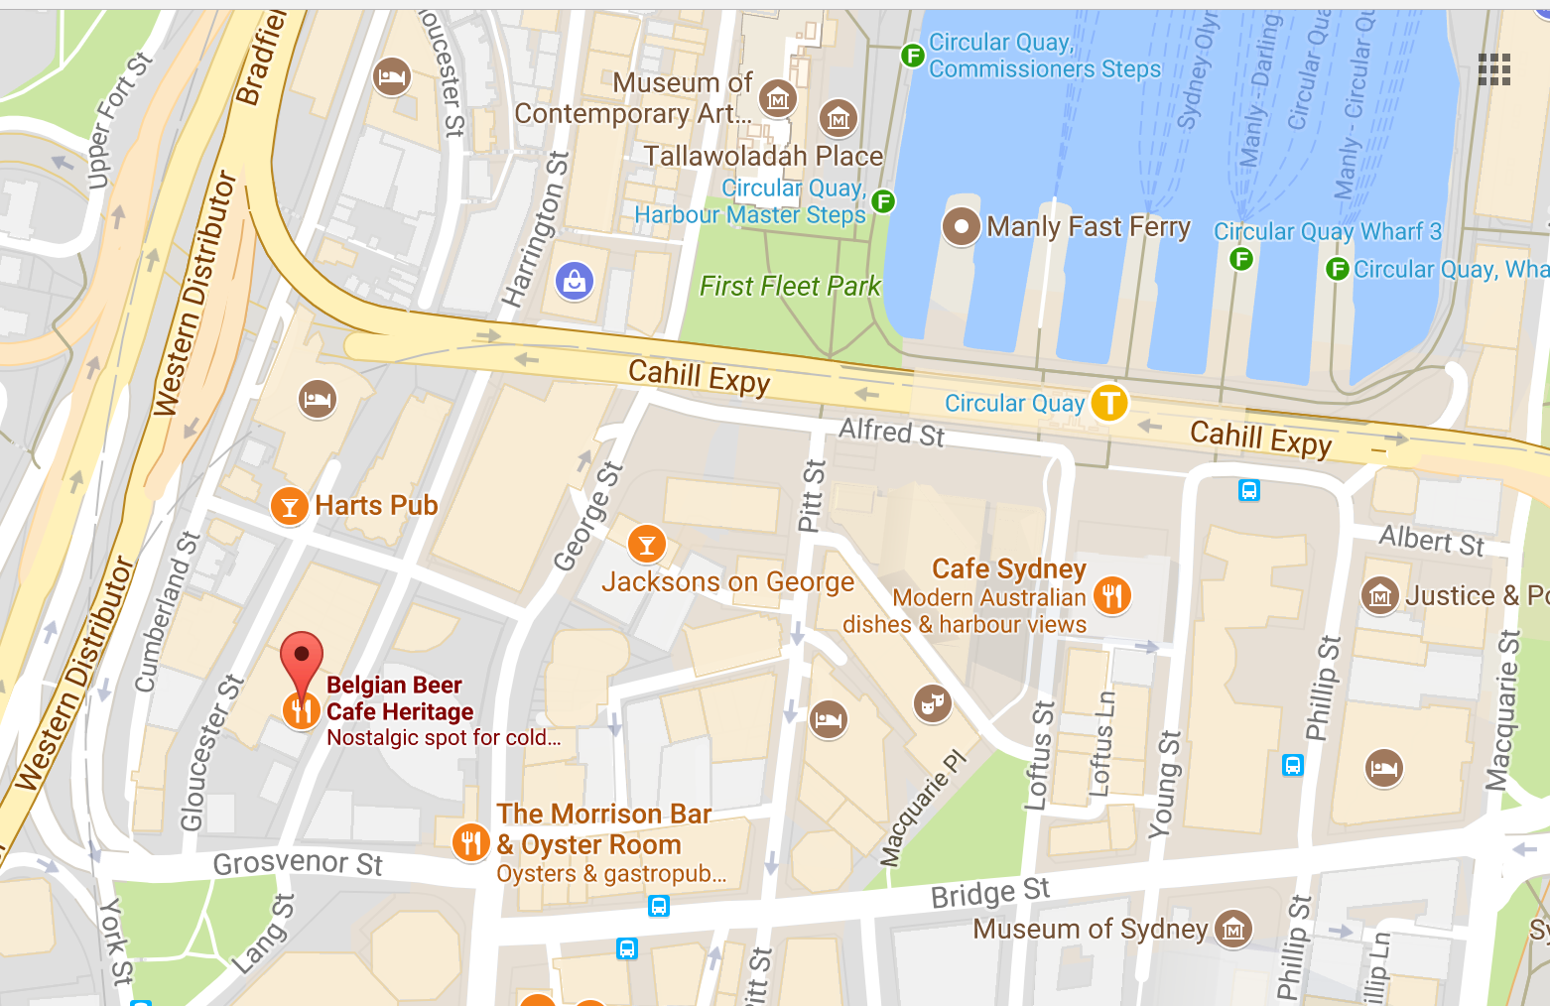
Casual Camel
Get-Together
Beers and Drinks at 3pm on Saturday August 12th at the Belgian Beer Cafe Heritage in The Rocks: http://www.bbcheritage.com.au/

Slide 6
Agenda
What is Apache Camel?
Little Example
What's in the Camel Box?
Tooling
Demo
More Information

Slide 7
What is Apache Camel?
Quote from the website
Apache Camel is a
powerful Open Source
Integration Framework
based on
Enterprise Integration Patterns

Slide 8
What is Apache Camel?
Quote from the website
Apache Camel is a
powerful Open Source
Integration Framework
based on
Enterprise Integration Patterns

Slide 9

Integration Framework

Slide 10
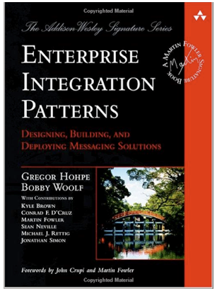
Enterprise Integration Patterns

Slide 11
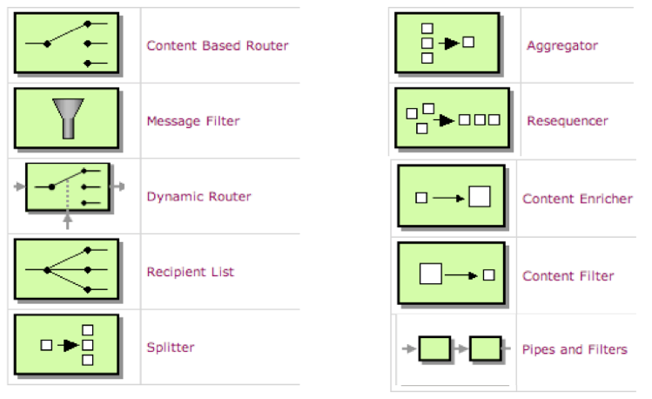
Enterprise Integration Patterns

Slide 12
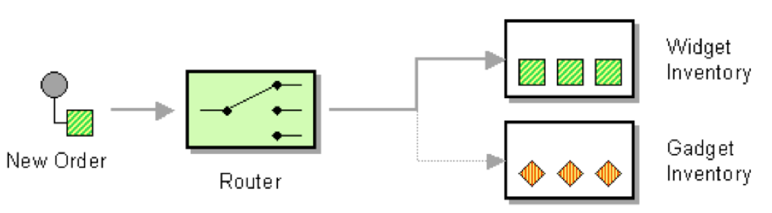
Content Based Router

Slide 13
Content Based Router
from newOrder

Slide 14
Content Based Router
from newOrder
choice

Slide 15
Content Based Router
from newOrder
choice
when isWidget to widget

Slide 16
Content Based Router
from newOrder
choice
when isWidget to widget
otherwise to gadget

Slide 17
Content Based Router
from(newOrder)
choice
when(isWidget) to(widget)
otherwise to(gadget)

Slide 18
Content Based Router
from(newOrder)
.choice()
.when(isWidget).to(widget)
.otherwise().to(gadget);

Slide 19
Content Based Router
Endpoint newOrder = endpoint("activemq:queue:newOrder");
from(newOrder)
.choice()
.when(isWidget).to(widget)
.otherwise().to(gadget);

Slide 20
Content Based Router
Endpoint newOrder = endpoint("activemq:queue:newOrder");
Predicate isWidget = xpath("/order/product = 'widget'");
from(newOrder)
.choice()
.when(isWidget).to(widget)
.otherwise().to(gadget);

Slide 21
Content Based Router
Endpoint newOrder = endpoint("activemq:queue:newOrder");
Predicate isWidget = xpath("/order/product = 'widget'");
Endpoint widget = endpoint("activemq:queue:widget");
Endpoint gadget = endpoint("activemq:queue:gadget");
from(newOrder)
.choice()
.when(isWidget).to(widget)
.otherwise().to(gadget);

Slide 22
Java Code
public void configure() throws Exception {
Endpoint newOrder = endpoint("activemq:queue:newOrder");
Predicate isWidget = xpath("/order/product = 'widget'");
Endpoint widget = endpoint("activemq:queue:widget");
Endpoint gadget = endpoint("activemq:queue:gadget");
from(newOrder)
.choice()
.when(isWidget).to(widget)
.otherwise().to(gadget);
}

Slide 23
Java Code
import org.apache.camel.Endpoint;
import org.apache.camel.Predicate;
import org.apache.camel.builder.RouteBuilder;
public class MyRoute extends RouteBuilder {
public void configure() throws Exception {
Endpoint newOrder = endpoint("activemq:queue:newOrder");
Predicate isWidget = xpath("/order/product = 'widget'");
Endpoint widget = endpoint("activemq:queue:widget");
Endpoint gadget = endpoint("activemq:queue:gadget");
from(newOrder)
.choice()
.when(isWidget).to(widget)
.otherwise().to(gadget);
}
}

Slide 24
Java DSL
import org.apache.camel.builder.RouteBuilder;
public class MyRoute extends RouteBuilder {
public void configure() throws Exception {
from("activemq:queue:newOrder")
.choice()
.when(xpath("/order/product = 'widget'"))
.to("activemq:queue:widget")
.otherwise()
.to("activemq:queue:gadget");
}
}

Slide 25
XML DSL
<route>
<from uri="activemq:queue:newOrder"/>
<choice>
<when>
<xpath>/order/product = 'widget'</xpath>
<to uri="activemq:queue:widget"/>
</when>
<otherwise>
<to uri="activemq:queue:gadget"/>
</otherwise>
</choice>
</route>

Slide 26

Endpoint URIs
<route>
<from uri="file:inbox/orders"/>
<choice>
<when>
<xpath>/order/product = 'widget'</xpath>
<to uri="activemq:queue:widget"/>
</when>
<otherwise>
<to uri="activemq:queue:gadget"/>
</otherwise>
</choice>
</route>
Use file instead

Slide 27
Endpoint URIs
<route>
<from uri="file:inbox/orders?delete=true"/>
<choice>
<when>
<xpath>/order/product = 'widget'</xpath>
<to uri="activemq:queue:widget"/>
</when>
<otherwise>
<to uri="activemq:queue:gadget"/>
</otherwise>
</choice>
</route>
Parameters

Slide 28
Endpoint URIs
<route>
<from uri="ftp:myserver/inbox?username=me&password=123"/>
<choice>
<when>
<xpath>/order/product = 'widget'</xpath>
<to uri="activemq:queue:widget"/>
</when>
<otherwise>
<to uri="activemq:queue:gadget"/>
</otherwise>
</choice>
</route>
Use FTP instead

Slide 29
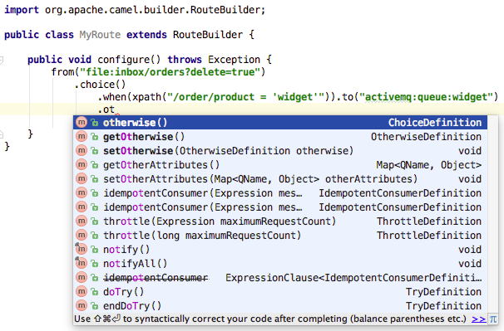
Just Java Code

Slide 30
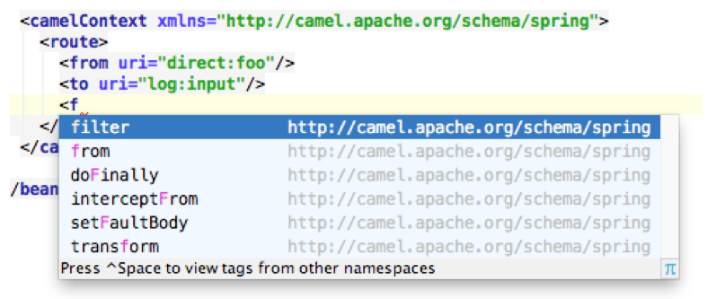
Just XML

Slide 31
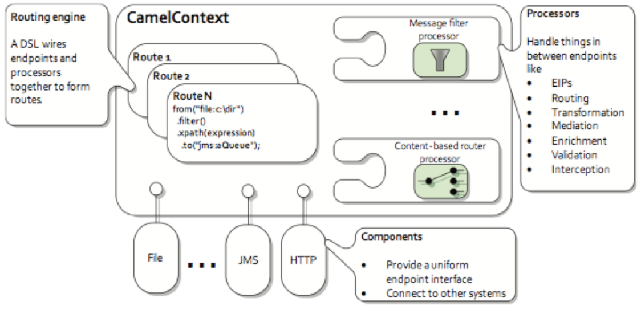
Architecture

Slide 32
Components
ahc | bindy | coap | docker
ahc-ws | blueprint | cometd | dozer
apns | boon | context | dropbox
atmosphere | box | couchdb | eclipse
atom | cache | crypto | ejb
aws | cassandraql | csv | elasticsearch
bam | castor | cfx | elsql
bean-validator | cdi | cxf-transport | eventadmin
beanio | chunk | disruptor | exec
beanstalk | cmis | dns | facebook

Slide 33
Components
flatpack | google-drive | hbase | jacksonxml
fop | google-mail | hdfs | jasypt
freemarker | gora | hdfs2 | javaspace
ftp | grape | http | jaxb
gae | groovy | http4 | jbpm
ganglia | gson | ibatis | jclouds
geocoder | guava-eventbus | ical | jcr
git | guice | infinispan | jdbc
github | hawtdb | irc | jetty8
google-calendar | hazelcast | jackson | jetty9

Slide 34
Components
jgroups | jsonpath | leveldb | mustache
jibx | jt400 | linkedin | mvel
jing | juel | lucene | mybatis
jira | jxpath | mail | netty
jms | kafka | metrics | netty-http
jmx | kestrel | mina | netty4
jolt | krati | mina2 | netty4-http
josql | kubernetes | mongodb | ognl
jpa | kura | mqtt | olingo2
jsch | ldap | msv | openshift

Slide 35
Components
optaplanner | rabbitmq | scala | smpp
paho | restlet | schematron | snpp
paxlogging | rmi | scr | soap
pdf | routebox | script | solr
pgevent | rss | servlet | spark-rest
printer | ruby | servletlistener | spring
protobuf | rx | shiro | spring-batch
quartz | salesforce | sip | spring-boot
quarz2 | sap-netweaver | sjms | spring-integration
quickfix | saxon | slack | spring-javaconfig

Slide 36
Components
spring-ldap | swagger | undertow | xmlsecurity
spring-redis | swagger-java | univocity | xmpp
spring-security | syslog | urlrewrite | xstream
spring-ws | tagsoup | velocity | yammer
sql | tarfile | vertx | zipfile
ssh | test | weather | zookeeper
stax | test-blueprint | websocket
stomp | test-spring | xmlbeans
stream | testng | xmljson
stringtemplate | twitter | xmlrpc

Slide 37


Slide 38
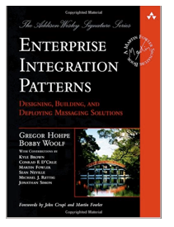
+

Slide 39
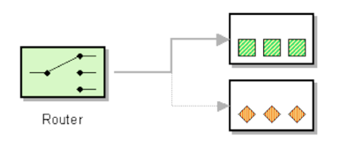
+
+

Slide 40
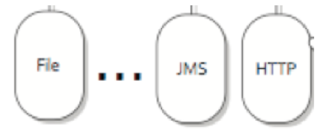
+
+
+

Slide 41

+
+
=
+

Slide 42
Agenda
What is Apache Camel?
Little Example
What's in the Camel Box?
Tooling
Demo
More Information

Slide 43
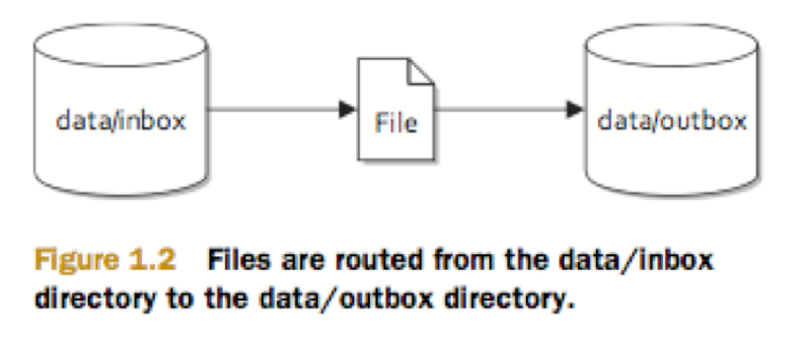
File Copier Example

Slide 44
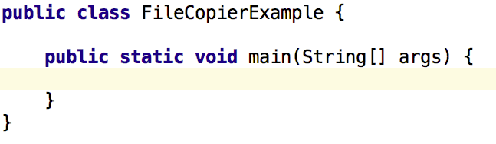
Public Static Void Main

Slide 45
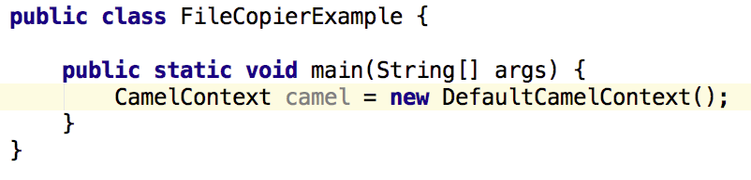
Create CamelContext

Slide 46
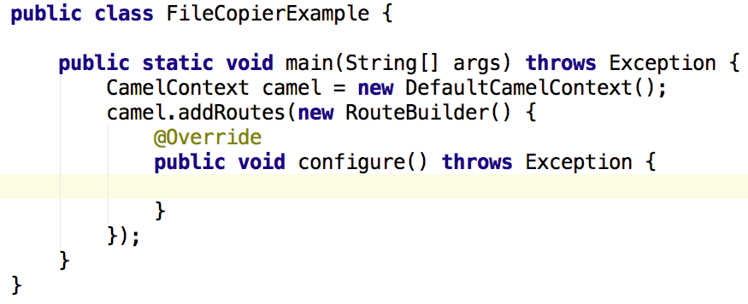
Add RouteBuilder

Slide 47
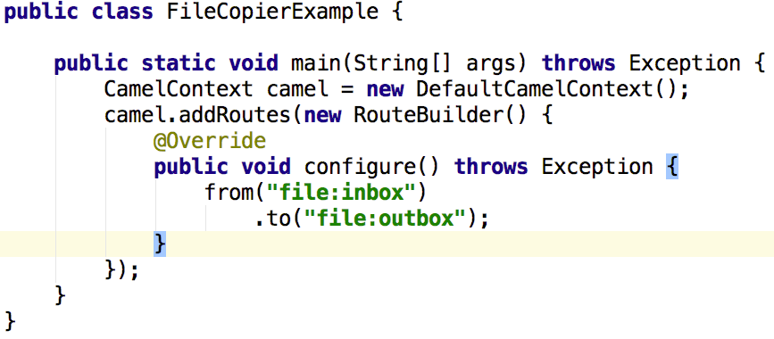
Java DSL

Slide 48
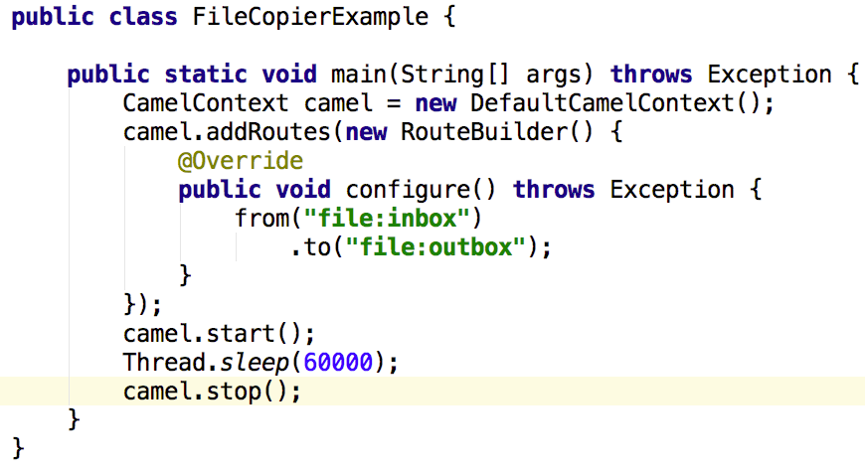
Start / Stop

Slide 49
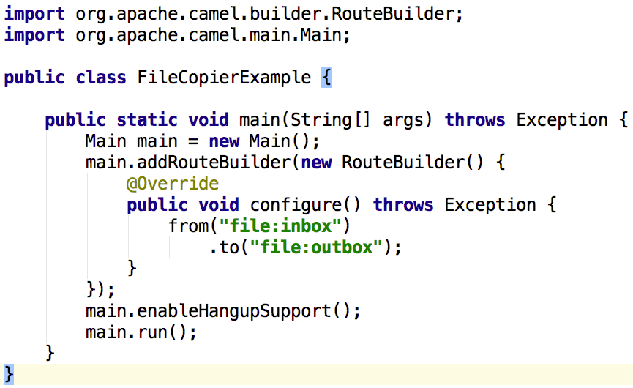
Camel Main

Slide 50
Agenda
What is Apache Camel?
Little Example
What's in the Camel Box?
Tooling
Demo
More Information

Slide 51

What's in the Camel Box?

Slide 52
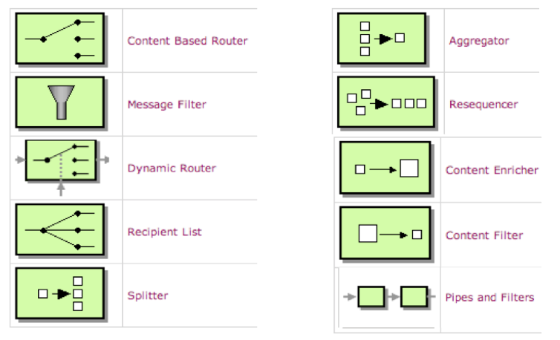
Enterprise Integration Patterns
http://camel.apache.org/eip

Slide 53
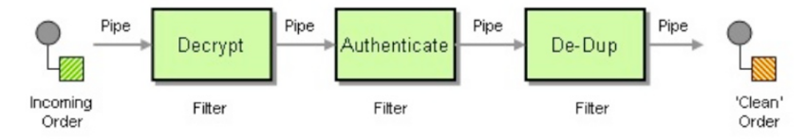
Pipes and Filters EIP
from("file:inbox")
.pipeline()
.to("bean:decrypt")
.to("bean:authenticate")
.to("bean:de-dup");

Slide 54
Pipes and Filters EIP
from("file:inbox")
.to("bean:decrypt")
.to("bean:authenticate")
.to("bean:de-dup");
pipeline is default mode so its nearly always omitted

Slide 55
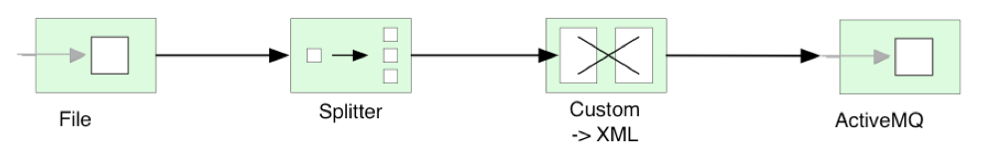
Splitter

Slide 56
Splitter
from("file:inbox")

Slide 57
Splitter
from("file:inbox")
.split(body().tokenize("\n"))

Slide 58
Splitter
from("file:inbox")
.split(body().tokenize("\n"))
.marshal(customToXml)
Custom Data Format

Slide 59
Splitter
from("file:inbox")
.split(body().tokenize("\n"))
.marshal(customToXml)
.to("activemq:line");
Custom Data Format

Slide 60
Components
ahc | bindy | coap | docker
ahc-ws | blueprint | cometd | dozer
apns | boon | context | dropbox
atmosphere | box | couchdb | eclipse
atom | cache | crypto | ejb
aws | cassandraql | csv | elasticsearch
bam | castor | cfx | elsql
bean-validator | cdi | cxf-transport | eventadmin
beanio | chunk | disruptor | exec
beanstalk | cmis | dns | facebook
Number of Components: 278 (191 JARs)

Slide 61
Data Formats
avro | flatpack | pgp | univocity-fixed
barcode | gzip | protobuf | univocity-tsv
base64 | hl7 | rss | xmlBeans
beanio | ical | secureXML | xmjson
bindy-csv | jacksonxml | serialization | xmlrpc
bindy-fixed | jaxb | soapjaxb | xstream
bindy-kvp | jibx | string | zip
boon | json-gson | syslog | zipfile
castor | json-jackson | tarfile
crypto | json-xstream | tidyMarkup
csv | mime-multipart | univocity-csv
Number of Data Formats: 45

Slide 62
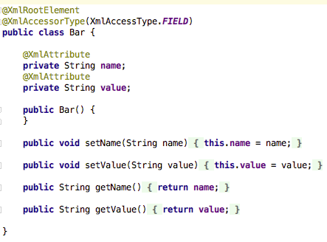
Data Format with JAXB
POJO class with @JAXB annotations

Slide 63
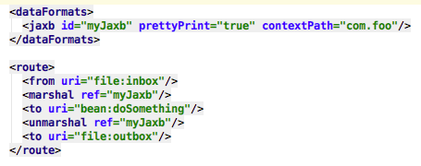
Data Format with JAXB
marshal (xml -> pojo)
unmarshal (pojo -> xml)

Slide 64
Languages
bean | header | php | sql
constant | javaScript | python | terser
el | jsonpath | ref | tokenize
exchange Property | jxpath | ruby | xpath
file | mvel | simple | xquery
groovy | ognl | spel | xtokenize
Number of Languages: 24

Slide 65
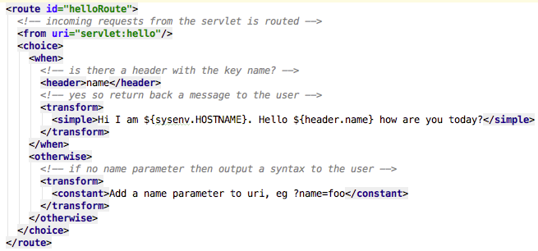
Language w/ Simple

Slide 66
Camel DSLs
Java DSL
XML DSL (spring or OSGi blueprint)
Groovy DSL
Scala DSL
Groovy and Scala are not much in use

Slide 67
Test Kit
camel-test | camel-test-blueprint
camel-test-cdi | camel-test-karaf
camel-test-spring | camel-testng

Slide 68
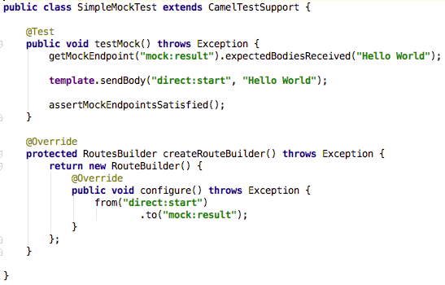
camel-test

Slide 69
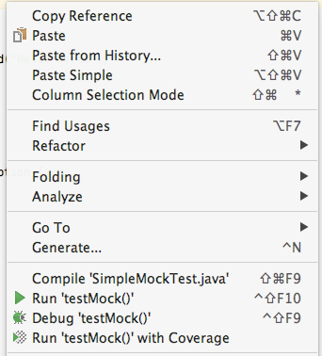
camel-test
easy to run or debug

Slide 70
camel-test
1) set expectations

Slide 71
camel-test
1) set expectations
2) send message(s)

Slide 72
camel-test
1) set expectations
2) send message(s)
3) assert

Slide 73
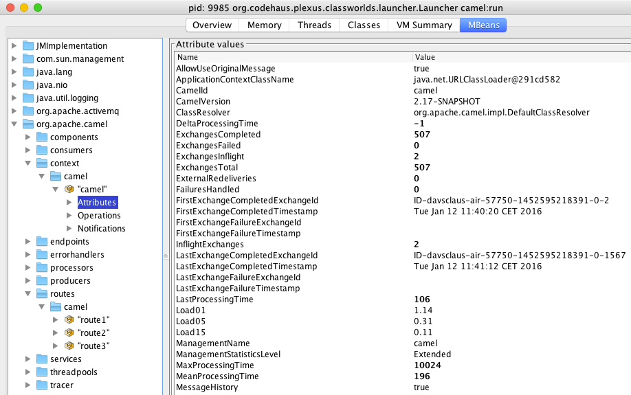
Management
JMX

Slide 74



Graceful Shutdown
Reliable Shutdown
Startup
Shutdown
Route A
1
6
Complete current
inflight messages
Route B
2
5
Stop accept new messages
Route C
3
4

Slide 75
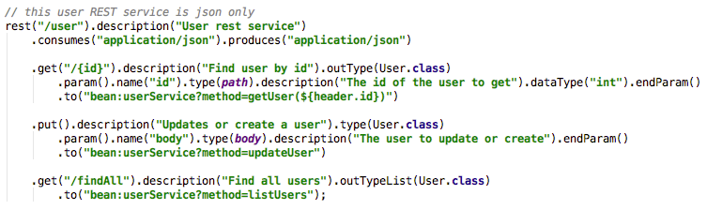
Rest DSL
use REST verbs to define services
that becomes Camel routes

Slide 76
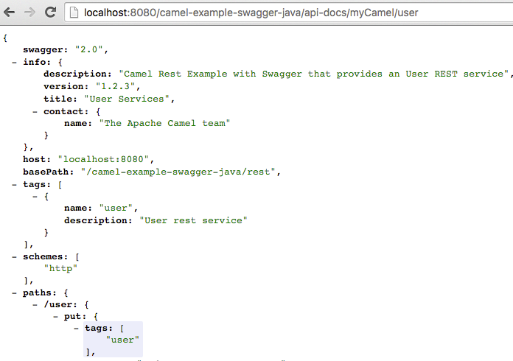
Rest DSL
swagger doc as JSon schema

Slide 77

Error Handling

Slide 78
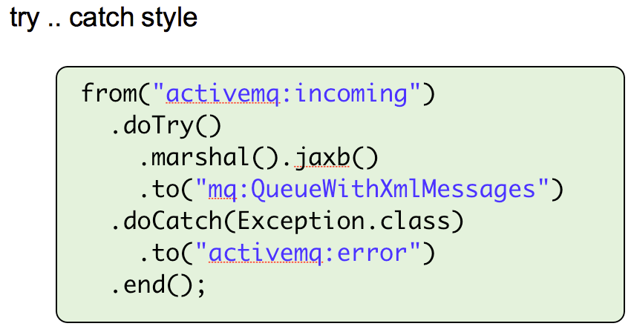
Error Handling

Slide 79
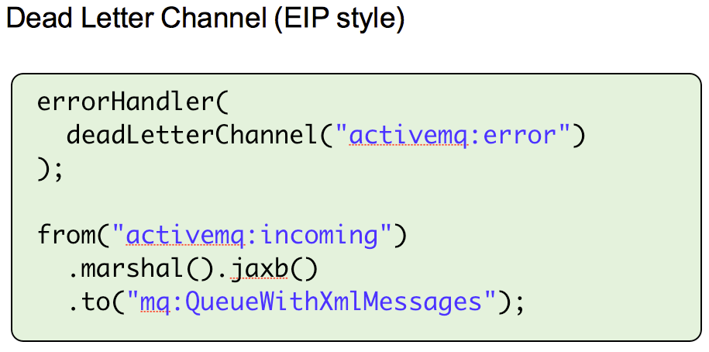
Error Handling

Slide 80
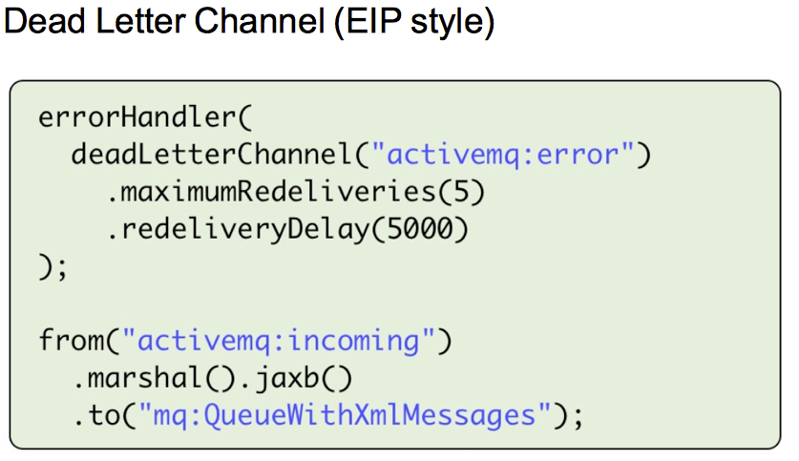
Error Handling

Slide 81



Error Handling
Client Side Retry
service ip:port
service ip:port
service ip:port
hello service
service ip:port
from timer
to http4
log
from undertow
transform
pod
pod

Slide 82
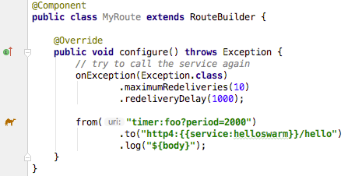
Error Handling
Client Side Retry

Slide 83
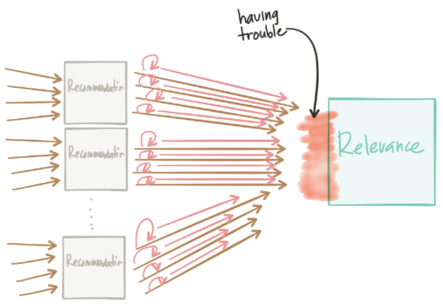
Error Handling
Thundering Herd Problem
Client Side Retry
Figure by Christian Posta

Slide 84
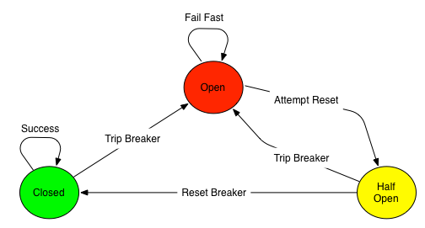
Error Handling
Client Side Circuit Breaker with Hystrix

Slide 85
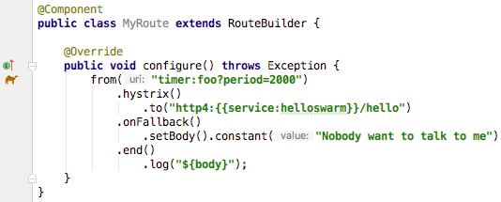
Error Handling
Client Side Circuit Breaker with Hystrix

Slide 86
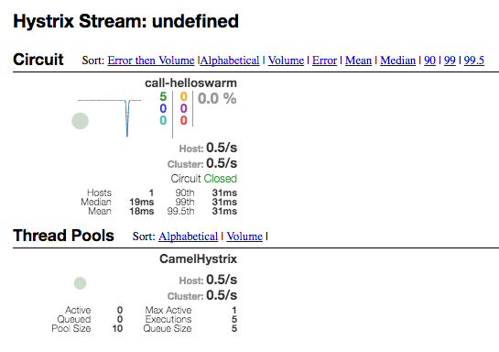
Hystrix Dashboard
Instructions in readme how to install and use

Slide 87
All the other stuff
Type Converter | Transactions
Interceptors | Security
Thread Management | Route Policy
Reactive | Asynchronous Non-Blocking Routing Engine
POJO Routing | Debugging & Tracing

Slide 88
Running Camel
Standalone | Web Application
Camel Spring XML | JEE Application
Camel Spring Boot | Apache Karaf (OSGi)
Camel CDI | Wildfly (wildfly-camel)
Camel Guice | vert.x (vertx-camel)

Slide 89
Agenda
What is Apache Camel?
Little Example
What's in the Camel Box?
Tooling
Demo
More Information

Slide 90
Maven Tooling
Archetypes
camel-archetype-java | camel-archetype-component
camel-archetype-spring | camel-archetype-api-component
camel-archetype-web | camel-archetype-dataformat
camel-archetype-cdi
camel-archetype-spring-boot | camel-archetype-scala
camel-archetype-blueprint | camel-archetype-groovy
camel-archetype-spring-dm
camel-archetype-scr | camel-archetype-java8
New in Camel 2.18

Slide 91

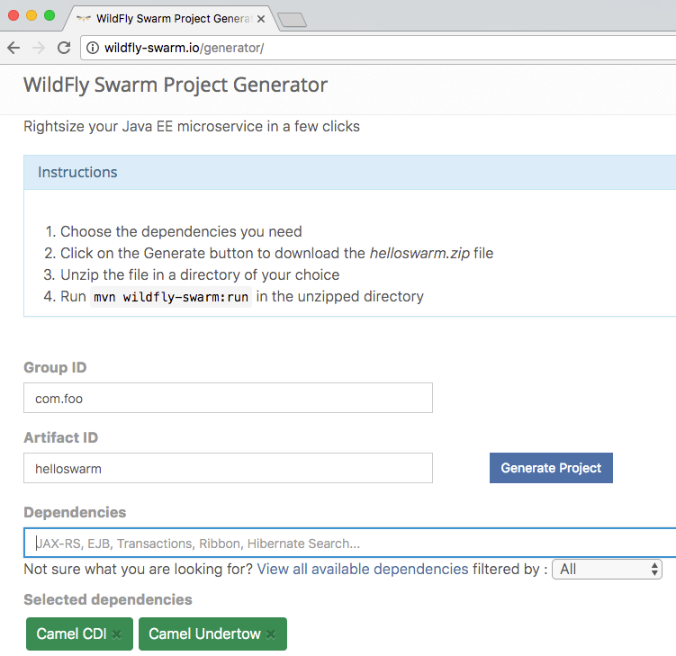
WildFly Swarm
Generator

Slide 92

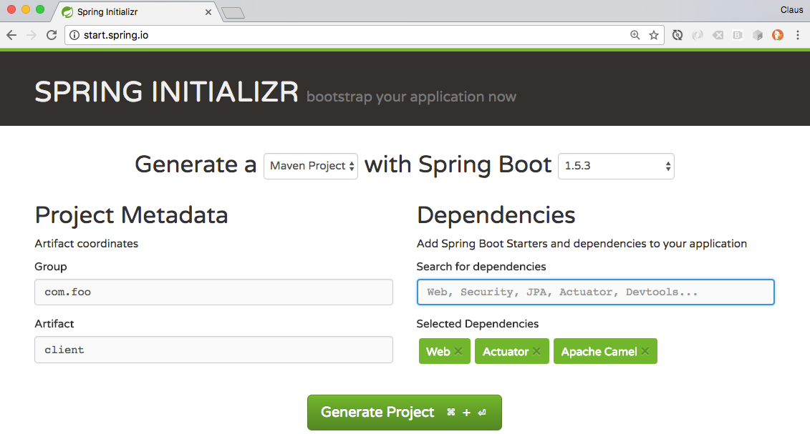
Spring Boot Starter

Slide 93
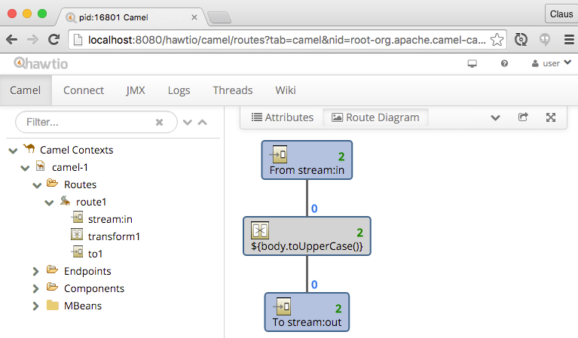
hawtio Web Console

Slide 94
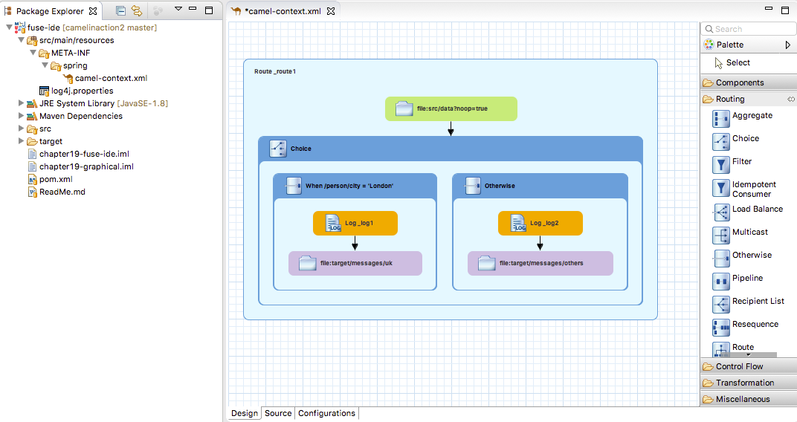
Eclipse GUI Tooling

Slide 95
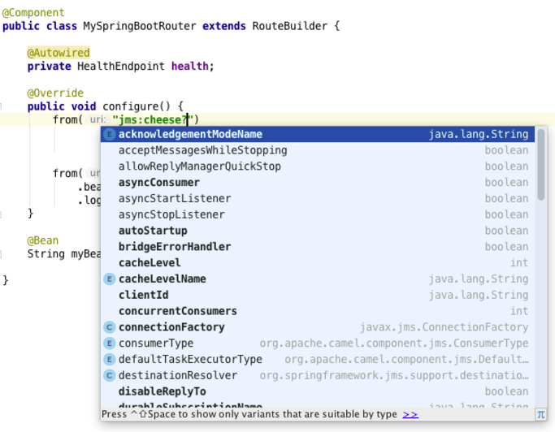
IntelliJ IDEA Tooling

Slide 96
Agenda
What is Apache Camel?
Little Example
What's in the Camel Box?
Tooling
Demo
More Information

Slide 97

Camel Demo

Slide 98
Agenda
What is Apache Camel?
Little Example
What's in the Camel Box?
Tooling
Demo
More Information

Slide 99
More Information
@davsclaus
davsclaus
www.davsclaus.com
cibsen@redhat.com
My blog
http://www.davsclaus.com
Apache Camel blogs & articles
http://camel.apache.org/articles
Camel videos
https://vimeo.com/tag:apachecamel
Best What is Camel article
https://dzone.com/articles/open-source-integration-apache
And a lot more on youtube

Slide 100
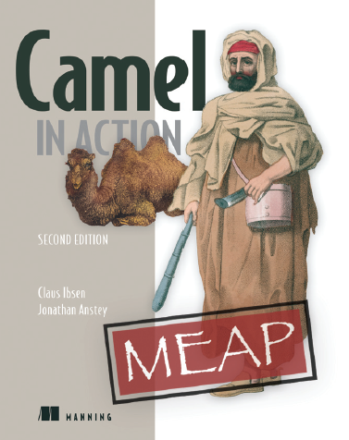
The Camel Bible
coupon code:
redhatcamel
https://www.manning.com/books/ibsen2

